Slide 1
IT Security and Penetration Testing
Chapter 3
Scanning Tools

Slide 2
Objectives
Comprehend the functioning of scanners
Trace the development of scanners
Identify various types of scanning
Identify different scanners
Computer Security and Penetration Testing

Slide 3
Scanning Tools
Scanners
  Find and fix vulnerabilities in remote machines on a network
  Software tool that examines and reports about vulnerabilities on local and remote hosts
Port scanner
  Examines and reports the condition (open or closed) of a port
    And the application listening on that port, if possible
Computer Security and Penetration Testing

Slide 4
Evolution of Scanners
Scanners first appeared even before ARPANET
  To monitor connections between mainframes and dumb terminals
The Internet was launched in the 1970s
The early UNIX-like languages had no security at all
Legitimate network users would connect to remote UNIX servers
  By having their modem dial specific telephone numbers
  Led to the invention of a new tool, the war dialer
Computer Security and Penetration Testing

Slide 5
Evolution of Scanners (continued)
War dialer
  Script that tells the modem to dial a range of phone numbers defined by the user
    And then identifies those numbers that connect to remote computers
  A form of automated scanner
In the early 1980s, the majority of servers ran on UNIX platforms
  System administrators created shell scripts that let them check security weaknesses of their networks
    And avoid hacking activities
Computer Security and Penetration Testing

Slide 6
Evolution of Scanners (continued)
As the Internet increased in availability and popularity
  More computers and networks became connected
Today, scanners are available for several popular platforms
Computer Security and Penetration Testing

Slide 7
How Scanners Work
Scanners automate the process of examining network weaknesses
Scanners are not heuristic
Functions
  Connects to a target host(s)
  Examines the target host for the services running on it
  Examines each service for any known vulnerability
Computer Security and Penetration Testing

Slide 8
Types of Scanning
TCP Connect Scanning
  Attempts to make TCP connections with all of the ports on a remote system
  Target host transmits connection-succeeded messages for active ports
  User does not need root privileges to perform TCP connect scanning
  Almost all IDSs recognize the scanning
Half-Open Scanning
  A TCP connection scanning that does not complete the connections
Computer Security and Penetration Testing

Slide 9
Types of Scanning (continued)
Half-Open Scanning (continued)
  Only the SYN message is sent from the scanner
  Reply signal may be a SYN/ACK, indicating the port is open
    Attacker replies with an RST flag to avoid detection
  Some IDSs can be configured to log all network activities
  Root or system administrator privileges are required to perform half-open scanning
Computer Security and Penetration Testing

Slide 10
Types of Scanning (continued)
UDP Scanning
  Examines the status of UDP ports on a target system
  Scanner sends a 0-byte UDP packet to all the ports on a target host
    If port is closed, the target host replies with an ICMP unreachable message
  Most operating systems generate UDP messages very slowly
    Makes UDP scanning impractical
Computer Security and Penetration Testing

Slide 11
Types of Scanning (continued)
IP Protocol Scanning
  Examines a target host for supported IP protocols
  Scanner transmits IP packets to each protocol on the target host
  If target host replies with an ICMP unreachable message to the scanner
    Then the target host does not use that protocol
Computer Security and Penetration Testing

Slide 12
Types of Scanning (continued)
Ping scanning
  Demonstrates whether a remote host is active by sending ICMP echo request packets to that host
Computer Security and Penetration Testing

Slide 13
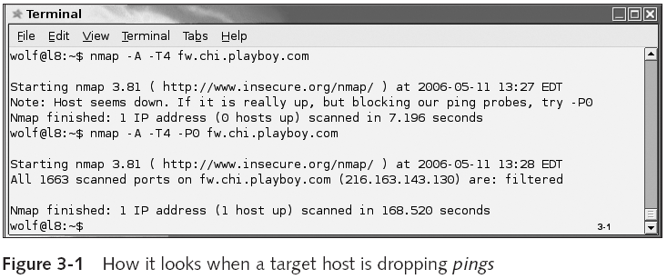
Types of Scanning (continued)
Computer Security and Penetration Testing

Slide 14
Types of Scanning (continued)
Stealth Scanning
  Lets you examine hosts behind firewalls and packet filters
  Most stealth scanners do not allow target hosts to log the scanning activities
Computer Security and Penetration Testing

Slide 15
Catalog of Scanner Technology
Popular scanners
  Nessus
  Network Mapper (Nmap)
  Security Auditor’s Research Assistant (SARA)
  Security Administrator’s Integrated Network Tool (SAINT)
  Strobe
  Cheops
Computer Security and Penetration Testing

Slide 16
Nessus
Formerly an open source vulnerability assessment tool
A remote security scanner designed to be run on Linux, BSD, Solaris, and other versions of Unix
Nessus was developed with a client/server architecture
  Nessus server performs the actual scanning activity
Nessus examines weaknesses of a network by utilizing a security vulnerability database
  Each security test is written as an external plug-in
Computer Security and Penetration Testing

Slide 17
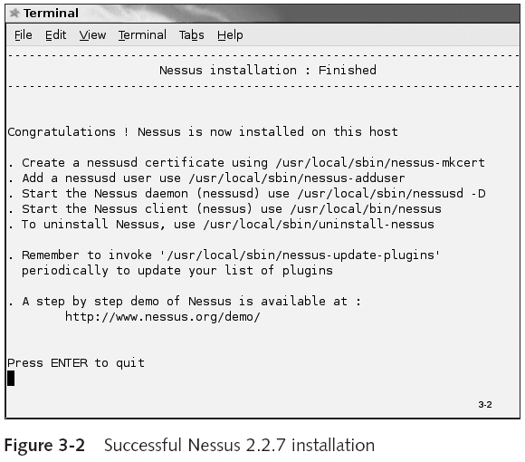
Computer Security and Penetration Testing

Slide 18
Nmap
Probably the best all-around network scanner to date
Nmap is powerful, yet easy to use
Nmap supports many different operating systems
Advantages
  Flexible
  Powerful
  Portable
  Easy
  Free
Computer Security and Penetration Testing

Slide 19
Nmap (continued)
Advantages (continued)
  Well documented
  Supported
  Acclaimed
  Popular
Using Nmap in Red Hat Linux
  Check for an installation of Nmap
    rpm -q nmap
  Check whether nmap-frontend is installed
    rpm -q nmap-frontend
Computer Security and Penetration Testing

Slide 20
Nmap (continued)
Using Nmap in Red Hat Linux (continued)
  Running Nmap from the command line
    nmap
  A very simple scan
    nmap -A 192.168.0.1
  Other examples
    nmap –A –P0 192.168.0.1
    nmap –P0 mit.edu
  Types of scanning supported by nmap
    See Table 3-1
Computer Security and Penetration Testing

Slide 21
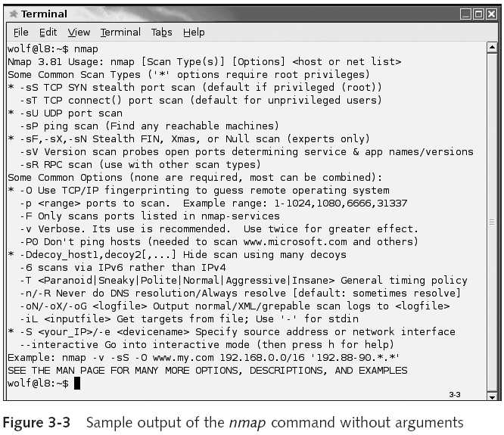
Computer Security and Penetration Testing

Slide 22
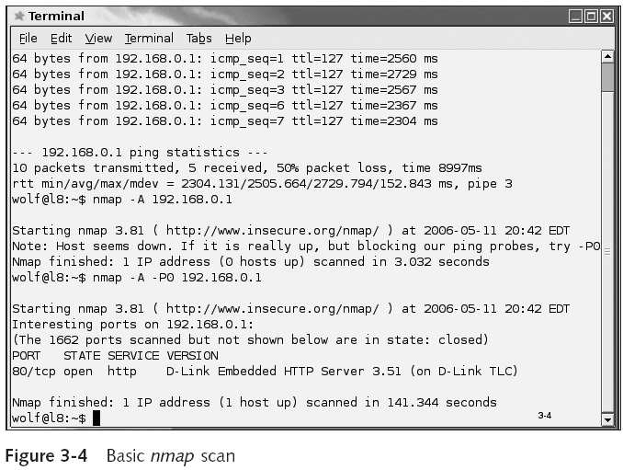
Computer Security and Penetration Testing

Slide 23
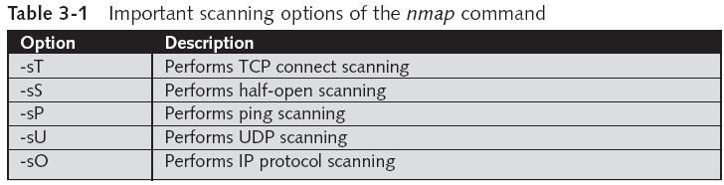
Nmap (continued)
Computer Security and Penetration Testing

Slide 24
Nmap (continued)
Using Nmap in Red Hat Linux
  Determining the operating system of the target
    Nmap –O ip_address
  Scanning multiple hosts
    nmap -O 192.168.0.100-110
  Scanning multiple networks using wildcards
    nmap -sS *.10.10.10
    nmap -sS 10.10.10.*
Computer Security and Penetration Testing

Slide 25
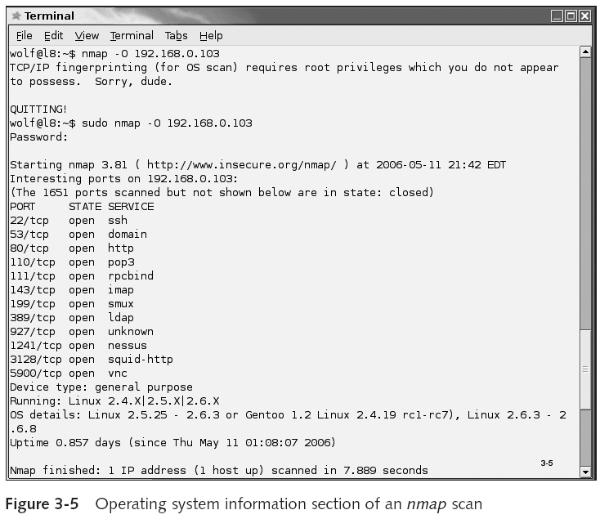
Computer Security and Penetration Testing

Slide 26
Nmap (continued)
NmapFE
  Graphic interface for the GNOME Linux Desktop
  You can run the nmapfe command in the “Run a Program” dialog box of the GNOME session
    To view the nmap front-end window
Computer Security and Penetration Testing

Slide 27
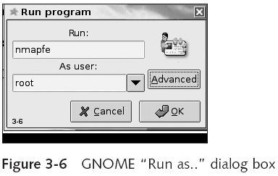
Nmap (continued)
Computer Security and Penetration Testing

Slide 28
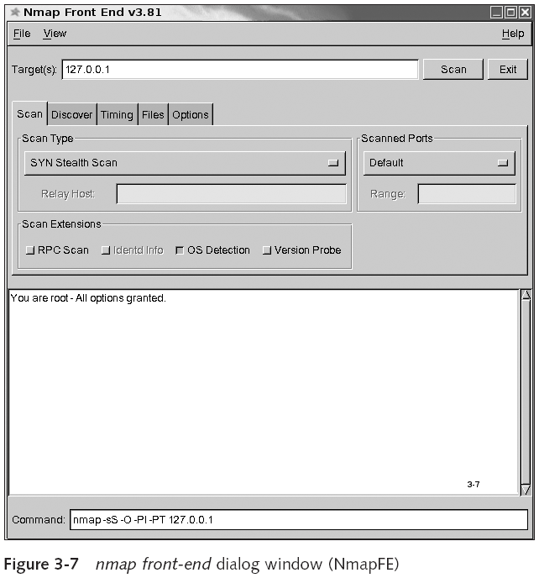
Computer Security and Penetration Testing

Slide 29
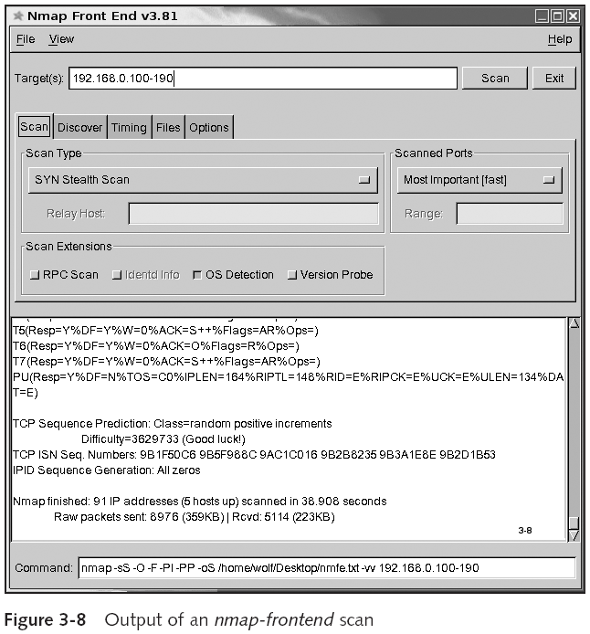
Computer Security and Penetration Testing

Slide 30
Nmap (continued)
Knmap
  Developed by Alexandre Sagala
  GUI for Nmap, to be used with the KDE desktop environment
  KNmap seems to have died at version 0.9
    Program has not been updated since 2002
Computer Security and Penetration Testing

Slide 31
SARA
Security Auditor’s Research Assistant (SARA)
  Third-generation network security analysis tool
  Developed by Advanced Research Corporation
  Based on a program called the Security Administrator’s Tool for Analyzing Networks (SATAN)
SARA was designed to complement and interface with other security tools
SARA runs on a variety of operating systems
Computer Security and Penetration Testing

Slide 32
SAINT
Security Administrator’s Integrated Network Tool
  Has a downloadable application
  Works on UNIX, Linux, and Mac OS X
  Produces an appliance to scan networks and an online “over-the-Internet” scanning application
SAINT is a viable commercial product suite and is not a popular hacker’s tool
Computer Security and Penetration Testing

Slide 33
Strobe
Strobe
  TCP port scanner for BSD and Red Hat
  Developed by Julian Assange
  Scans for all open ports on the target host
Its scanning activity is reputed to be very fast
  Yet it is many years old with no apparent live project page
Computer Security and Penetration Testing

Slide 34
Cheops
Port scanner for Linux operating systems
Developed for the GNOME interface by using the GTK+ kit
Uses a dramatically large percentage of cpu cycles and slows all other applications to a crawl
Computer Security and Penetration Testing

Slide 35
Summary
Scanning permits hackers to learn the vulnerabilities of the target system
The most popular scanners are open source or freeware, made freely available across the Internet
In the early days of computing, security vulnerabilities, while abundant, were not well known
When hackers wanted to crack a system in the 1970s, they would examine the target system for all known vulnerabilities
Computer Security and Penetration Testing

Slide 36
Summary (continued)
As students and hobbyists started playing with scanning applications, new vulnerabilities were discovered
In the early 1980s, most servers ran on UNIX platforms
  System administrators created shell scripts that let them check security weaknesses
Scanners automate the process of examining network weaknesses, and check only for known vulnerabilities and open ports
Computer Security and Penetration Testing

Slide 37
Summary (continued)
Scanners can be set to target a single IP address or a range of addresses
Scanners are available on UNIX, Windows, and Macintosh platforms
Scanning outside your own network can get you blocked by your own ISP, if the target servers are running IDS systems
Computer Security and Penetration Testing

